Slide 1

A MACHINE LEARNING MODEL FOR AVERAGE FUEL CONSUMPTION IN HEAVY VEHICLES
DEPARTMENT OF COMPUTER SCIENCE AND ENGINEERING
PROJECT PRESENTED BY:
N.DEVA KUMARI [198H1A0530]
SHAIK KARIMULLA [198H1A0535]
A.TEJESWINI [198H1A0502]
K.ANIL KUMAR [198H1A0522]
UNDER THE GUIDANCE OF:
Mr.N.VENKATESWARA RAO M.Tech
Assistant Professor

Slide 2
CONTENTS
Abstract
Introduction
Existing system
Proposed system
Architecture Design
Software requirements
Hardware requirements
UML diagrams
Result
Conclusion
Future work

Slide 3
ABSTRACT
Data summarization approach based on distance rather than the traditional time period when developing individualized machine learning models for fuel consumption .This approach is used in conjunction with seven predictors derived from vehicle speed and road grade to produce a highly predictive neural network model for average fuel consumption in heavy vehicles . The proposed model can easily be developed and deployed for each individual vehicle in a fleet in order to optimize fuel consumption over the entire fleet. The predictors of the model are aggregated over fixed window sizes of distance traveled.Different window sizes are evaluated and the results show that a 1 km window is able to predict fuel consumption with a 0.91 coefficient of determination and mean absolute peak-to-peak percent error less than 4% for routes that include both city and highway duty cycle segments.

Slide 4
INTRODUCTION
FUEL consumption models for vehicles are of interest to manufacturers, regulators, and consumers. They are needed across all the phases of the vehicle life-cycle.
In this Project, we focus on modeling average fuel consumption for heavy vehicles during the operation and maintenance phase.
In general, techniques used to develop models for fuel consumption fall under three main categories:
Physics-based models
Machine learning models
Statistical models

Slide 5
EXISTING SYSTEM
Model that can be easily developed for individual heavy vehicles in a large fleet is proposed. Relying on accurate models of all of the vehicles in a fleet, a fleet manager can optimize the route planning for all of the vehicles based on each unique vehicle predicted fuel consumption thereby ensuring the route assignments are aligned to minimize overall fleet fuel consumption.

Slide 6
PROPOSED SYSTEM
This approach is used in conjunction with seven predictors derived from vehicle speed and road grade to produce a highly predictive neural network model for average fuel consumption in heavy vehicles.
Different window sizes are evaluated and the results show that a 1 km window is able to predict fuel consumption with a 0.91 coefficient of determination and mean absolute peak-to-peak percent error less than 4% for routes that include both city and highway duty cycle segments.

Slide 7
ADVANTAGES OF PROPOSED SYSTEM:
Data is collected at a rate that is directly proportional to its impact on the outcome.
The predictors in the model are able to capture the impact of both the duty cycle and the environment on the average fuel consumption of the fuel consumption.
Data summarization is best performed on-board near the source of the data.

Slide 8
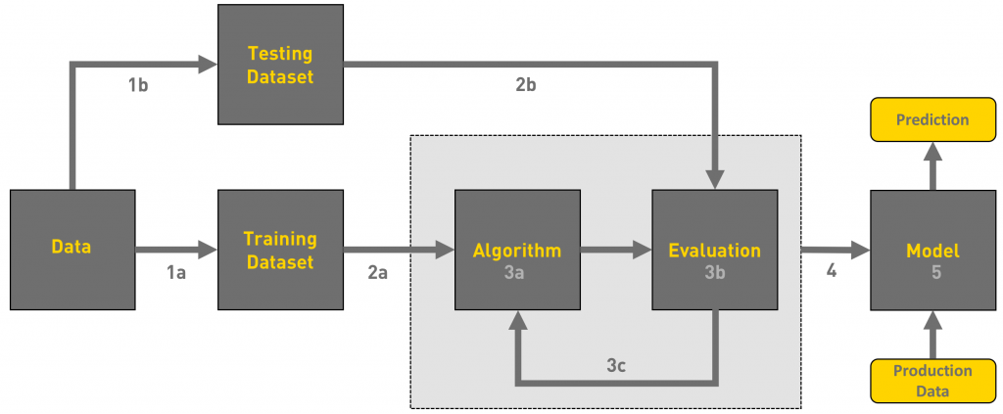
ARCHITECTURE DESIGN

Slide 9
HARDWARE REQUIREMENTS
Operating System supported by
1. Windows 7 / XP/ 8
Processor – Intel i3 Processor
RAM -- 4 GB
Space on Hard Disk – 1 TB

Slide 10
SOFTWARE REQUIREMENTS
For developing the Application
1. Python
2. Django
3. Mysql
4. Mysqlclient
5. WampServer 2.4
Language used to Develop - Python

Slide 11
UML DIAGRAM
UML stands for Unified Modeling Language. UML is a standardized general-purpose modeling language in the field of object-oriented software engineering. The standard is managed, and was created by, the Object Management Group

Slide 12
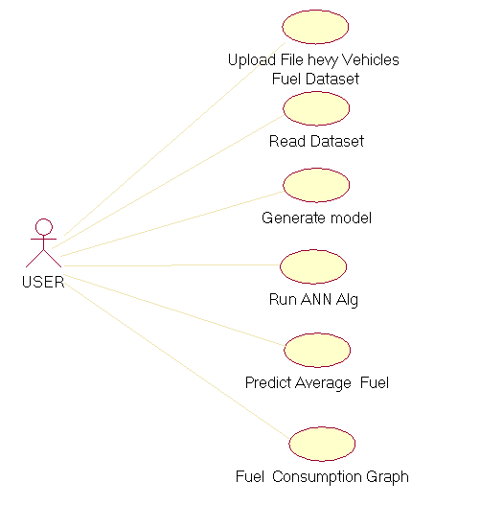
USECASE DIAGRAM

Slide 13
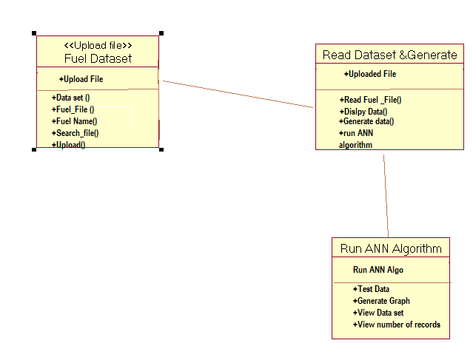
CLASS DIAGRAM

Slide 14
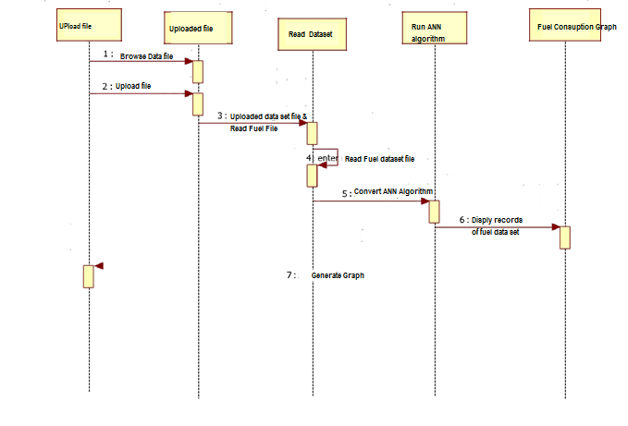
SEQUENCE DIAGRAM

Slide 15
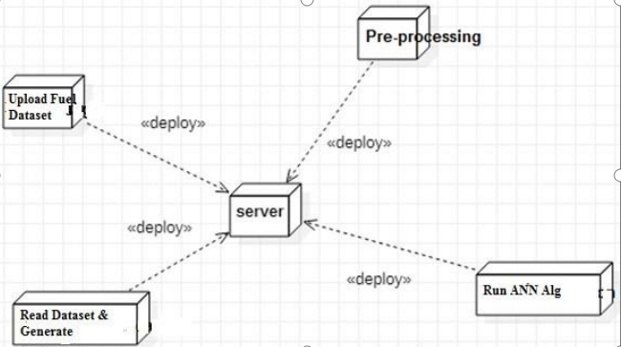
Component Diagram

Slide 16
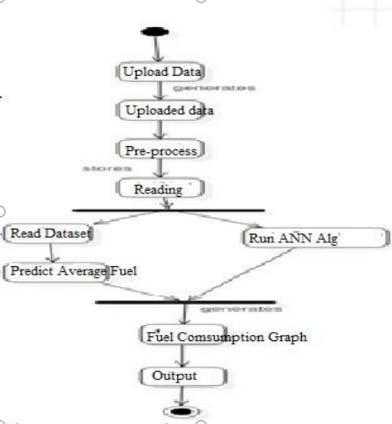
ACTIVITY DIAGRAM

Slide 17
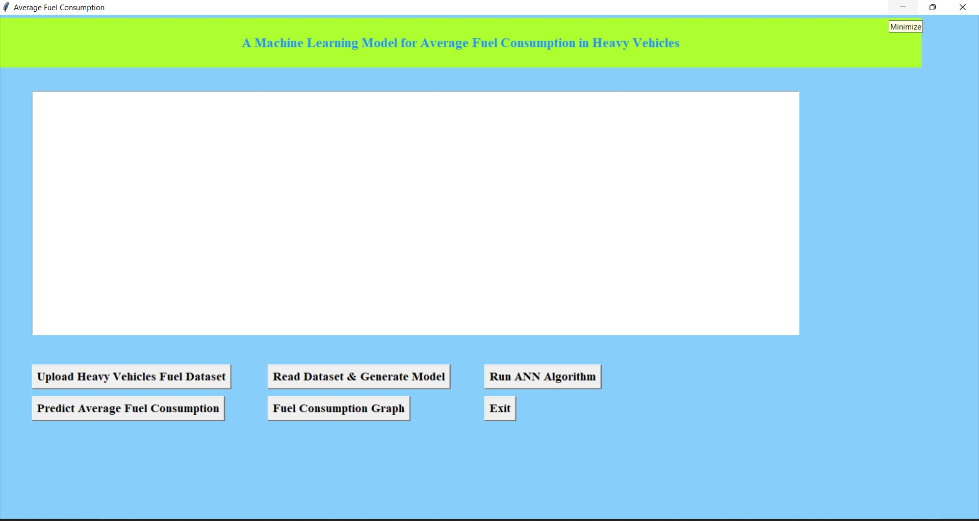
RESULT
In above screen click on “Upload Heavy Vehicles fuel dataset”button to upload train dataset

Slide 18
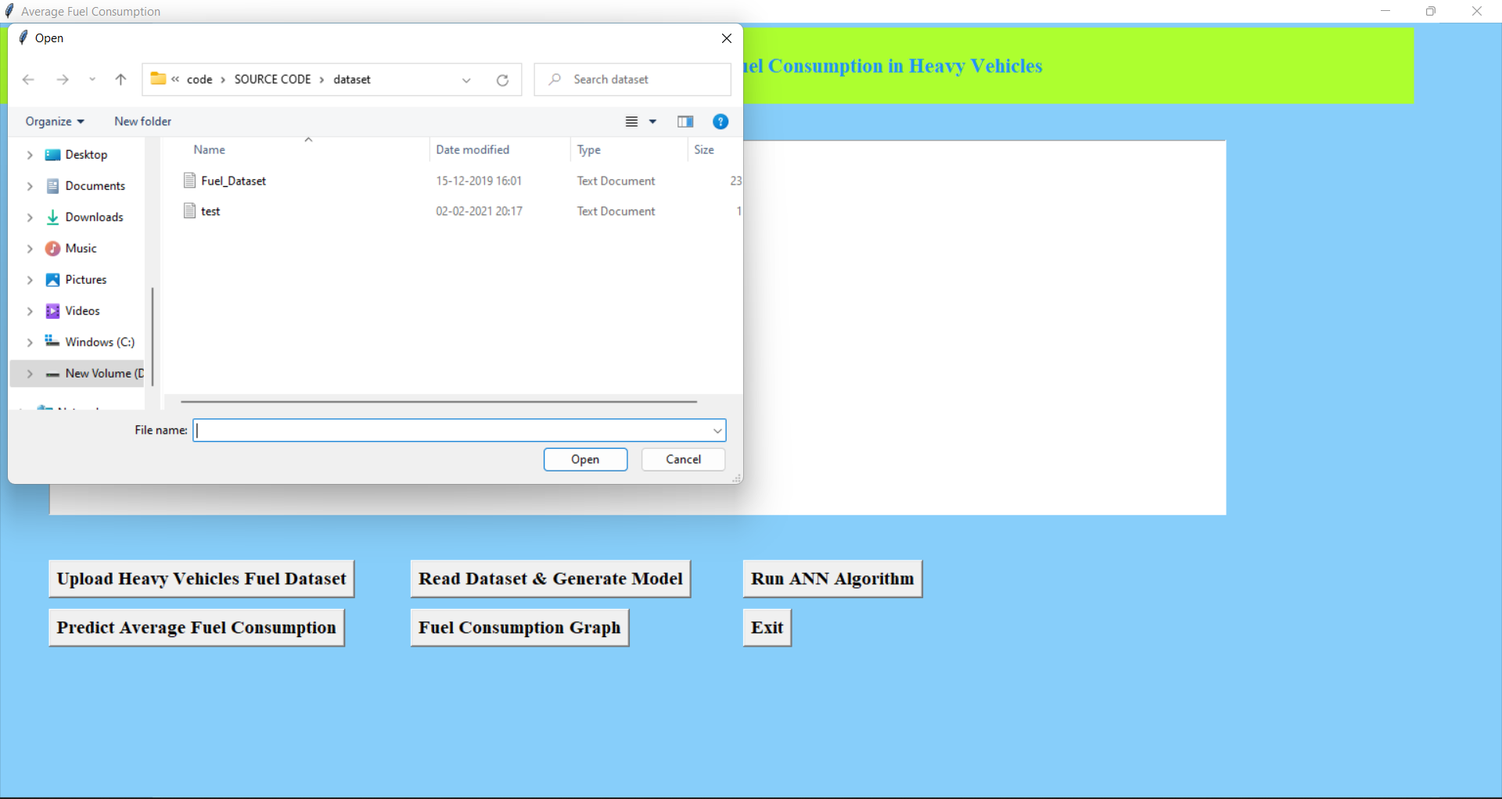
In above screen uploading “Fuel Dataset.txt” which can be used to train model. after uploading dataset will get below screen

Slide 19
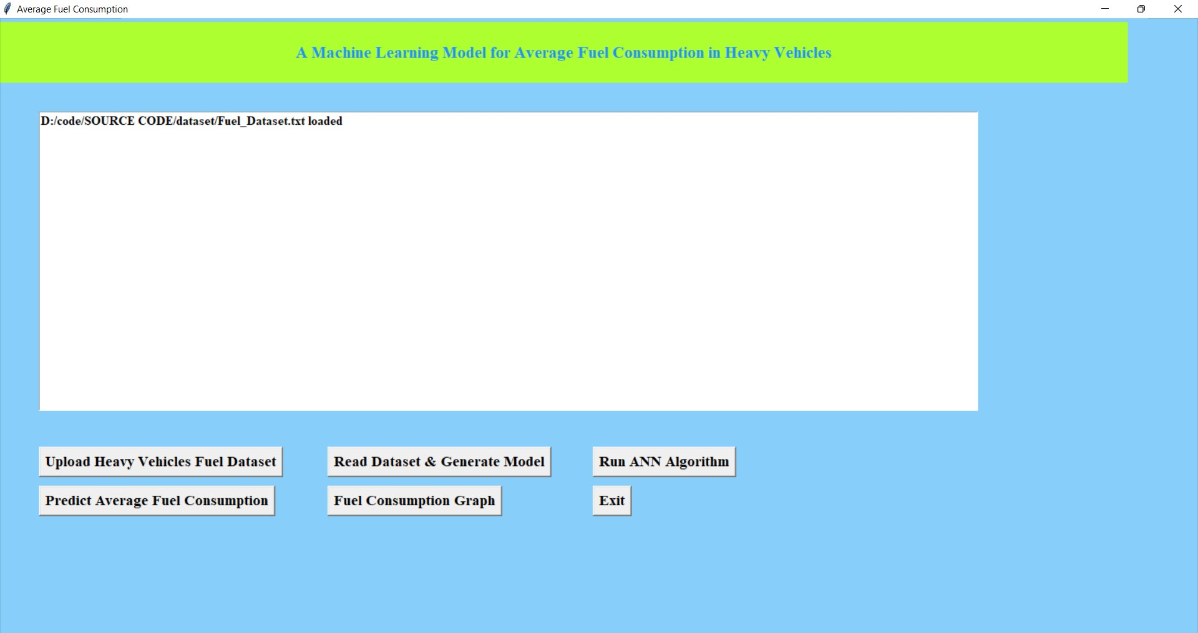

Slide 20
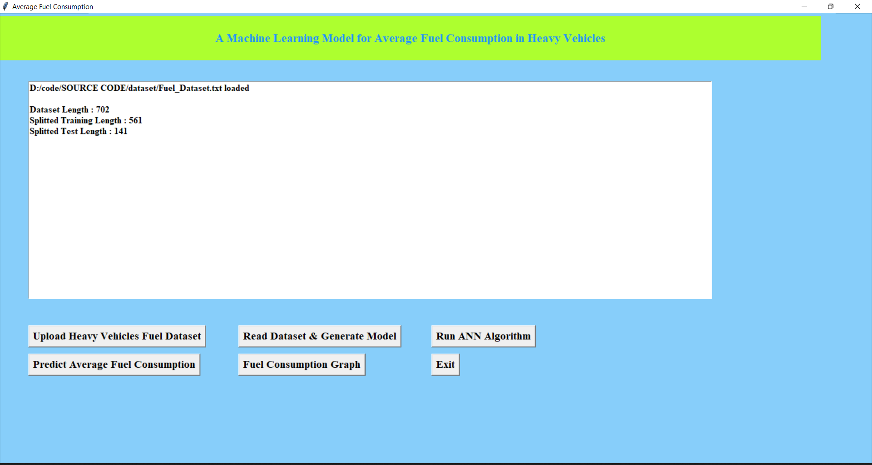
In above screen clock on “Read Dataset& Generate Model” button to read uploaded to generate train and test data

Slide 21
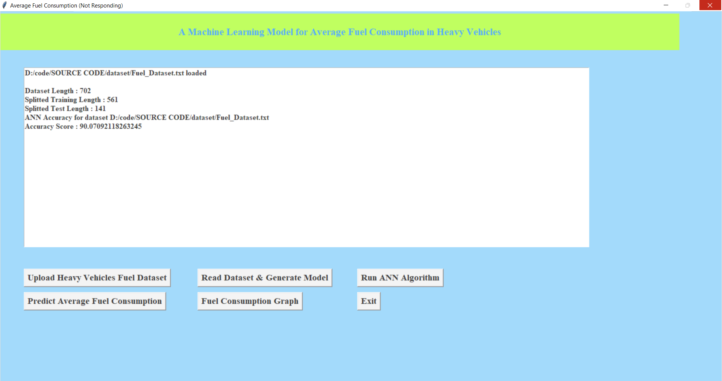
In the above we got ANN prediction accuracy 90%. Now click on” Predict Average Fuel Consumption” button to upload test data and to predict consumption for test data

Slide 22
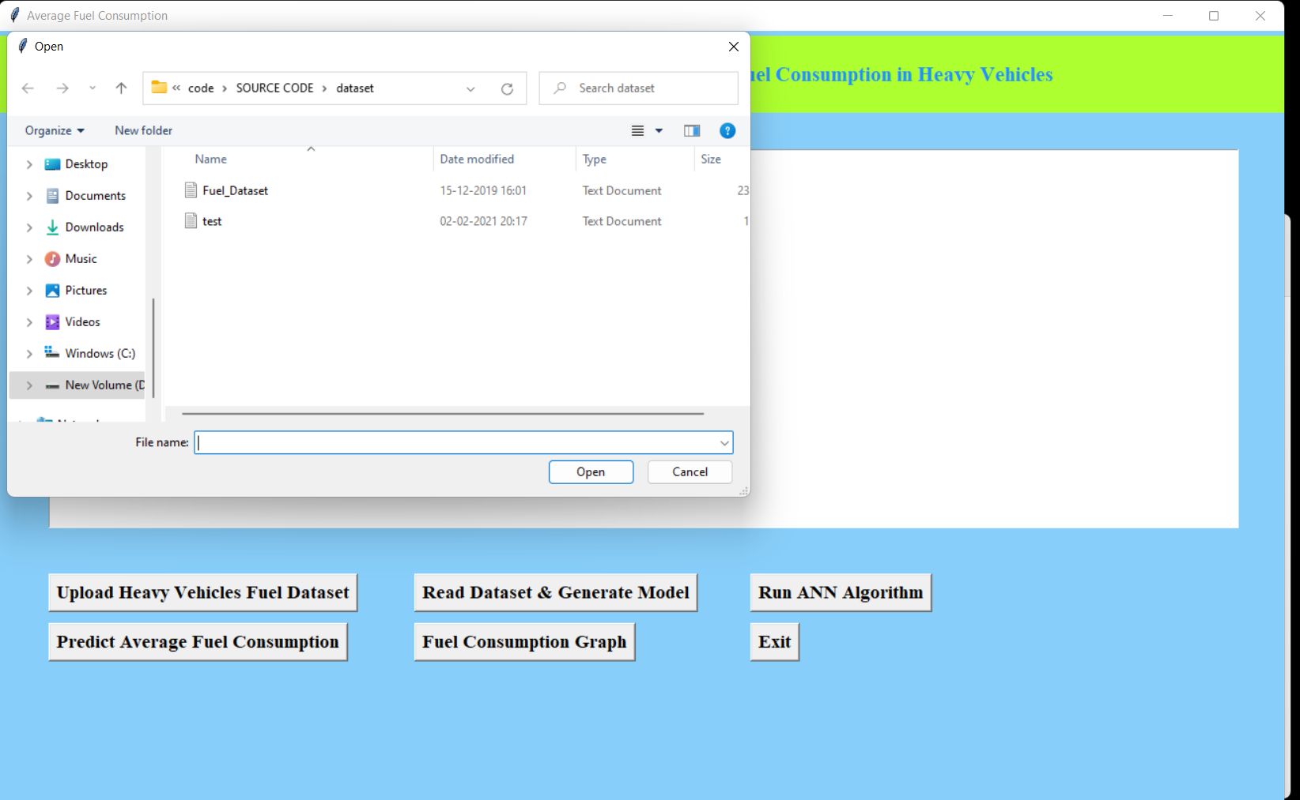
After uploading test data will get fuel consumption prediction result in below screen

Slide 23
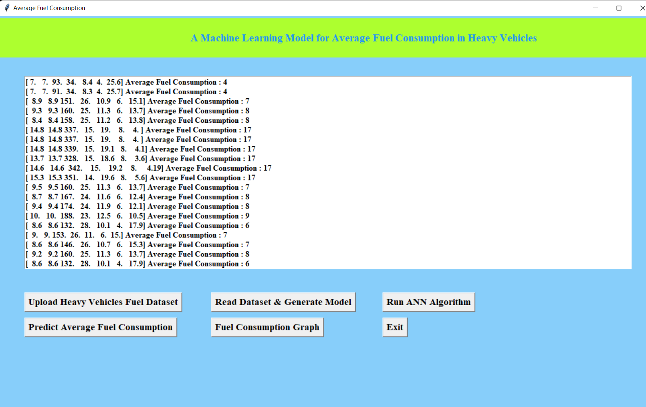

Slide 24
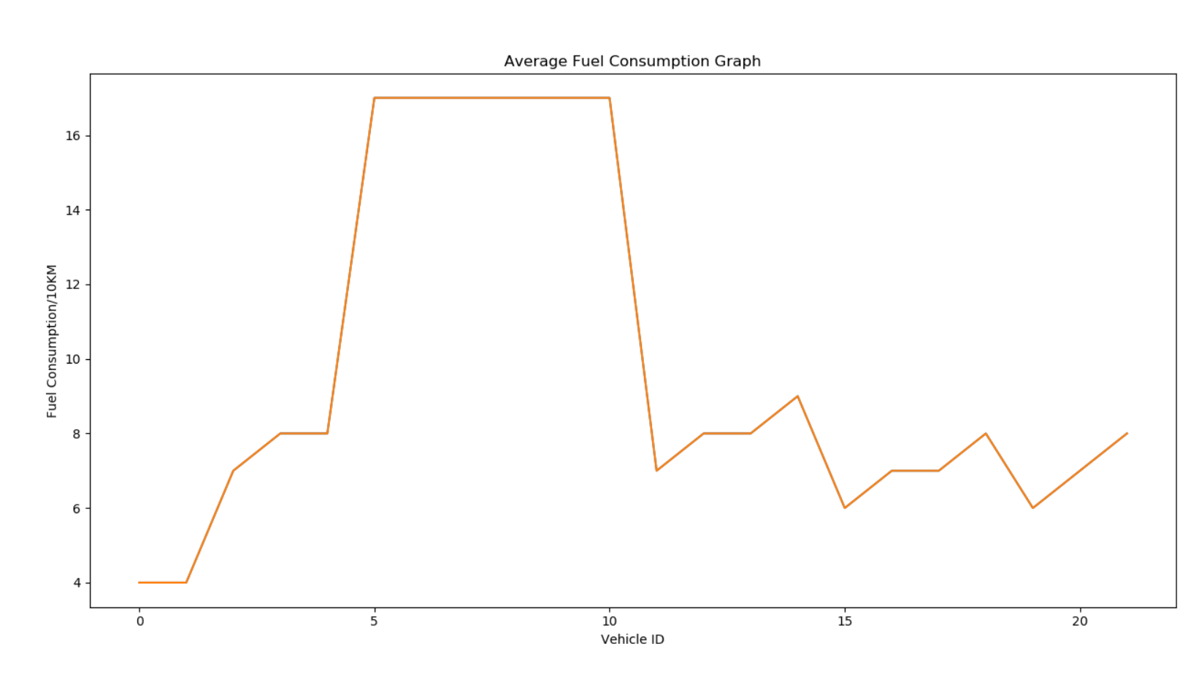
Now click on “Average Fuel Consumption graph’ to view above graph

Slide 25
CONCLUSION
machine learning model that can be conveniently developed for each heavy vehicle in a fleet.
The model relies on seven predictors: number of stops, stop time, average moving speed, characteristic acceleration, aerodynamic speed squared, change in kinetic energy and change in potential energy.
The last two predictors are introduced in this paper to help capture the average dynamic behavior of the vehicle. All of the predictors of the model are derived from vehicle speed and road grade.

Slide 26
FUTURE WORK
Future work also includes investigating the minimum distance required for training each model and analyzing how often does a model need to be synchronized with the physical system in operation by using online training in order to maintain the prediction accuracy of the model.

Slide 27
ANY QUERY?

Slide 28
THANK YOU

